Slide 1
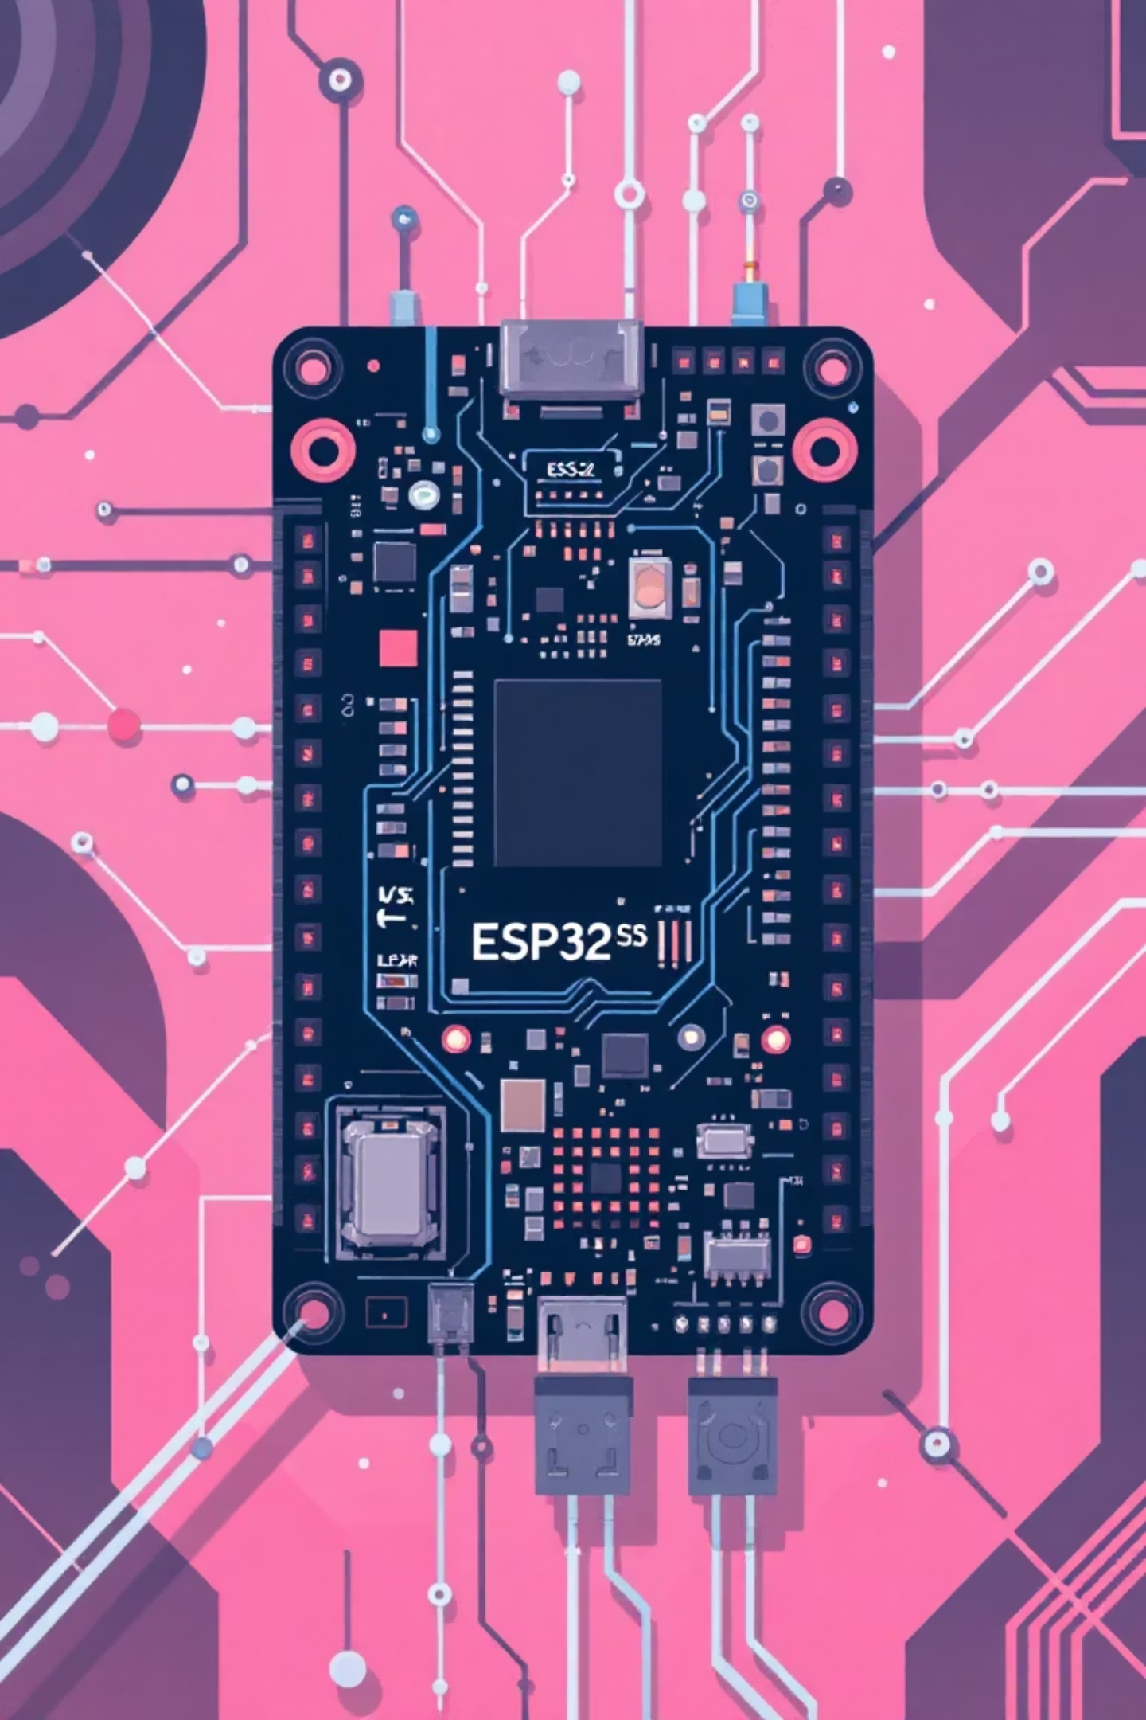
RTOS Stopwatch System
Md Sajib Pramanic
Junaid Khan
Mariya
Abdul

Slide 2
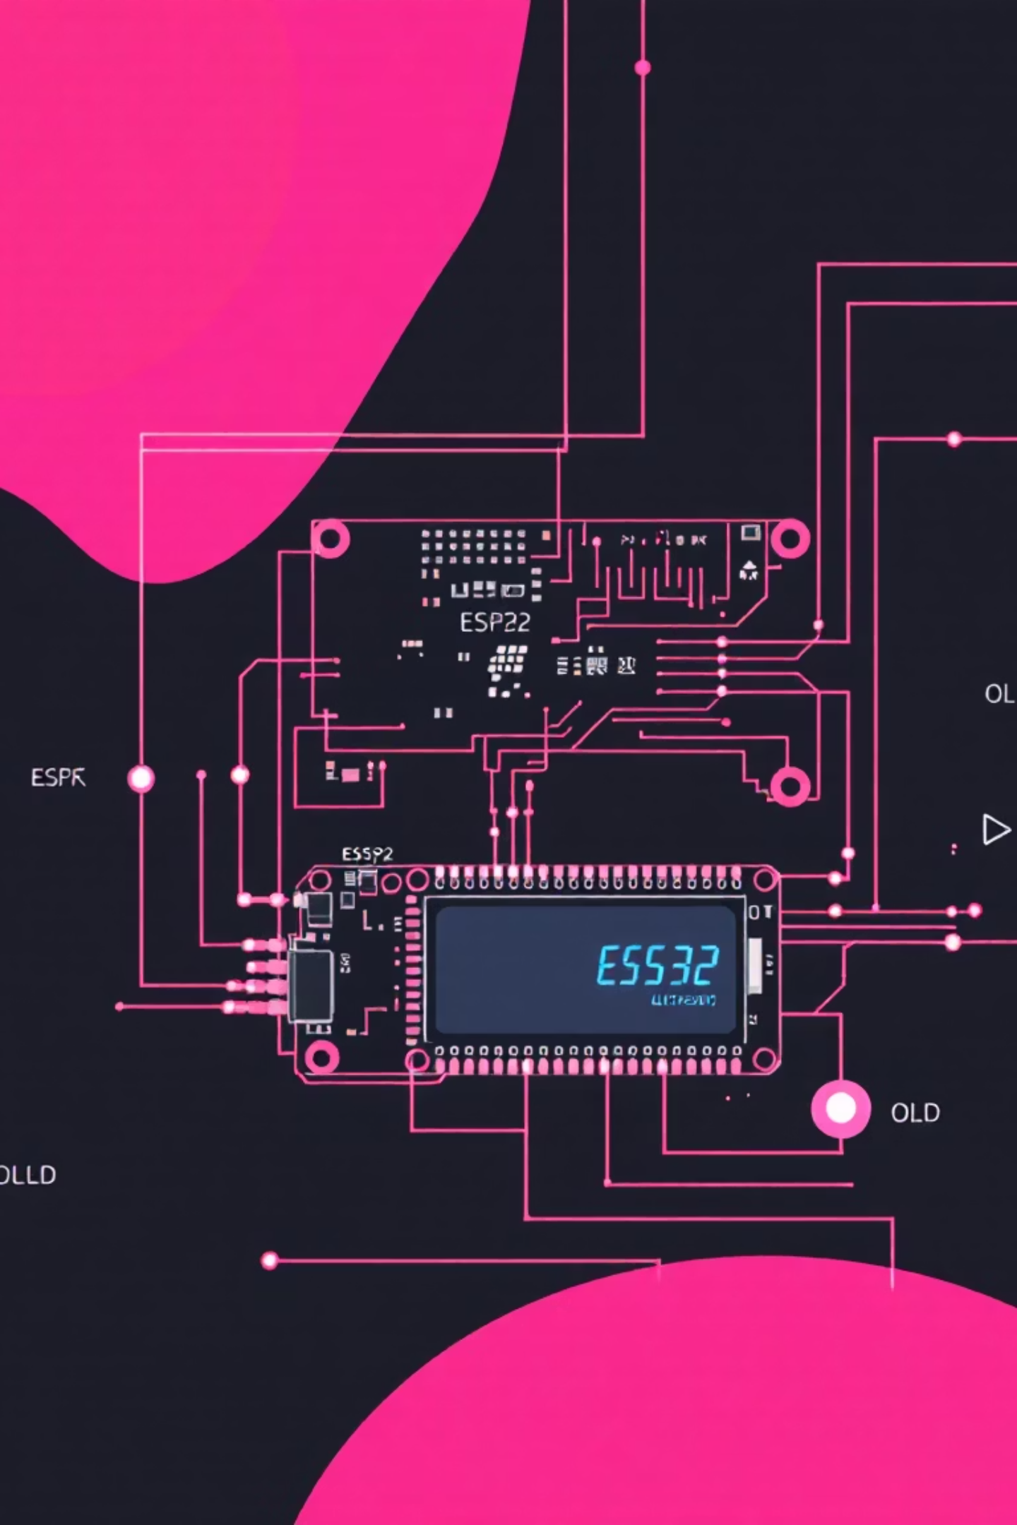
Hardware Architecture
Ultrasonic Sensor
TRIG: Pin 17, ECHO: Pin 18. Detects objects within 10cm proximity.
OLED Display
SDA: Pin 14, SCL: Pin 13. Shows HH:MM:SS format timing data.
RGB LED Indicators
Red (Pin 4), Yellow (Pin 5), Green (Pin 6). Status signaling via color.
Push Button
Pin 8. Manual pause and state reset control.

Slide 3
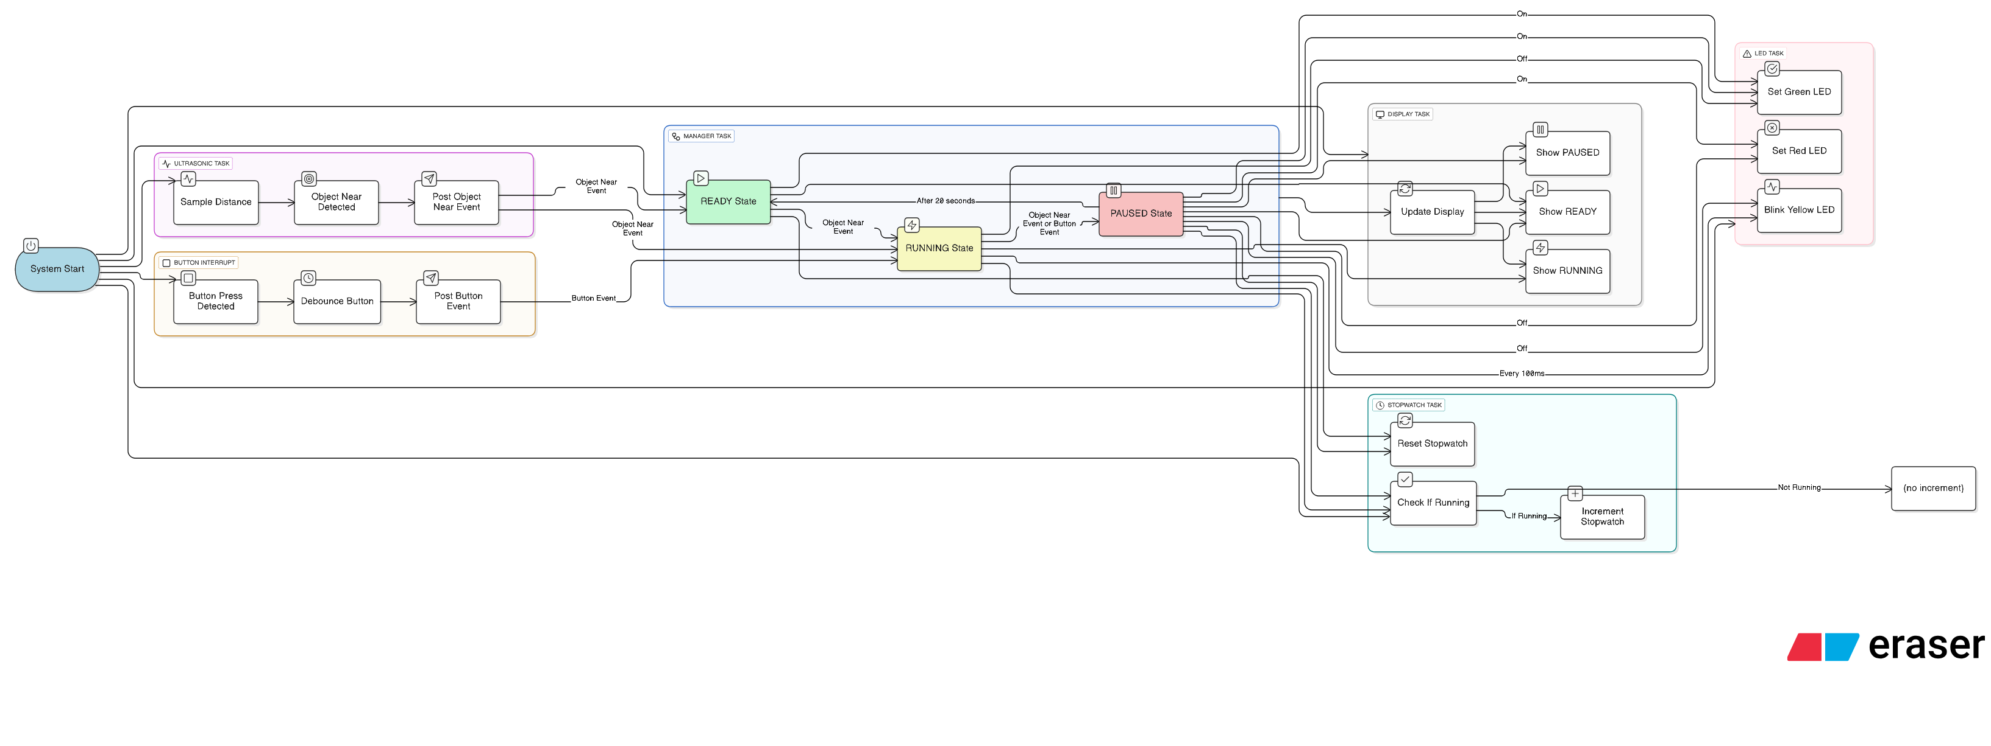

Slide 4




System State Machine
READY
RUNNING
PAUSED
The system cycles through three distinct operational states. Each transition is managed by RTOS schedulers to ensure deterministic timing and proper resource allocation.

Slide 5

Initial State: System Ready
Ready Configuration
GREEN LED continuously ON
OLED displays "00:00:00"
Timer halted, waiting for trigger
Ultrasonic sensor actively polling
System awaits object detection

Slide 6

Running State: Active Timing
When an object enters the 10cm proximity zone, the system automatically transitions to active timing mode.
Trigger Condition
LED Response
Ultrasonic sensor detects object ≤10cm distance threshold.
GREEN LED turns OFF. YELLOW LED begins millisecond-synchronized blinking pattern.
Timer Operation
Stopwatch counts continuously from 00:00:00 on OLED display with high precision.

Slide 7

Paused State: Stop Conditions
The timer pauses when either condition is met, holding for exactly 10 seconds before reset.
Sensor Exit
Button Press
Object leaves 10cm zone
User manually triggers reset
Pause Response: YELLOW LED turns OFF. RED LED activates. OLED freezes current time. System holds paused state for 10 seconds, then returns to Initial state automatically.

Slide 8








RTOS Architecture
Real-time operating system manages concurrent task execution with priority scheduling and resource synchronization.
Scheduler
Mutex & Semaphore
Preemptive scheduling with priority levels. Ensures time-critical sensor polling meets strict deadlines.
Protects shared OLED display buffer and LED state variables from race conditions between tasks.
Priority Queues
Interrupt Handling
Events sorted by urgency. Sensor detections and button presses processed in deterministic order.
Button press and sensor edge triggers handled via ISRs with priority queue management.

Slide 9
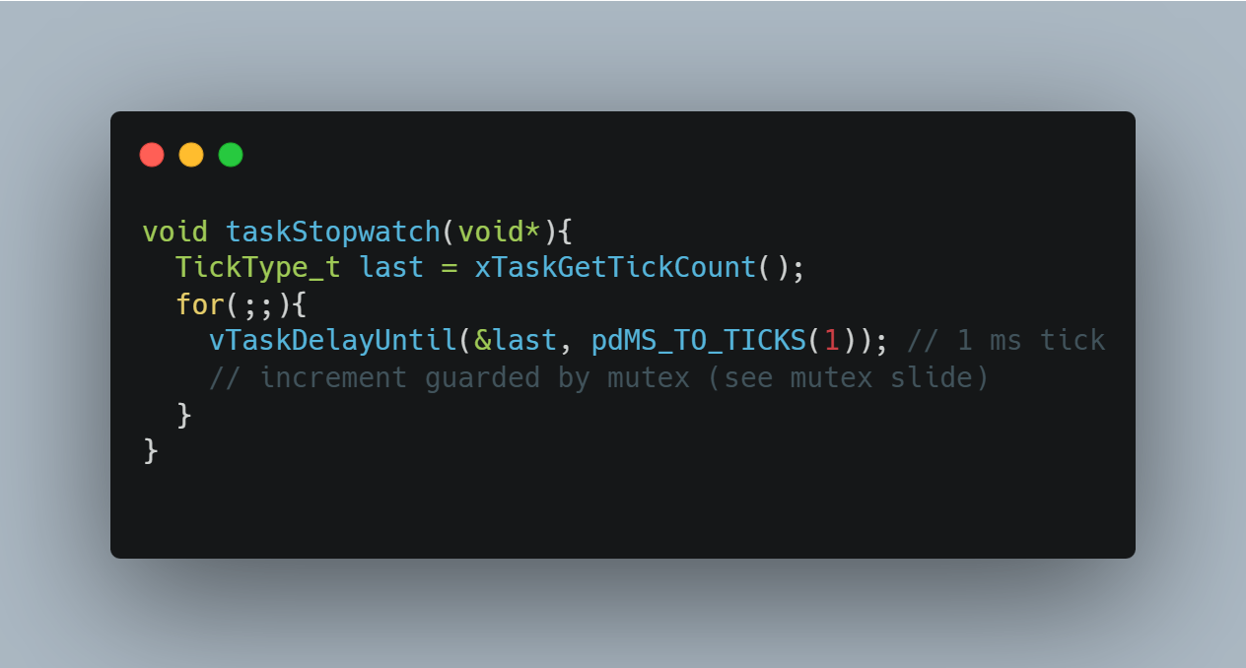
Task synchronization (deterministic timing)
The stopwatch uses a precise 1 ms cadence with vTaskDelayUntil, avoiding busy-wait and jitter.
Periodic delays keep the scheduler fair and CPU free for other tasks.

Slide 10
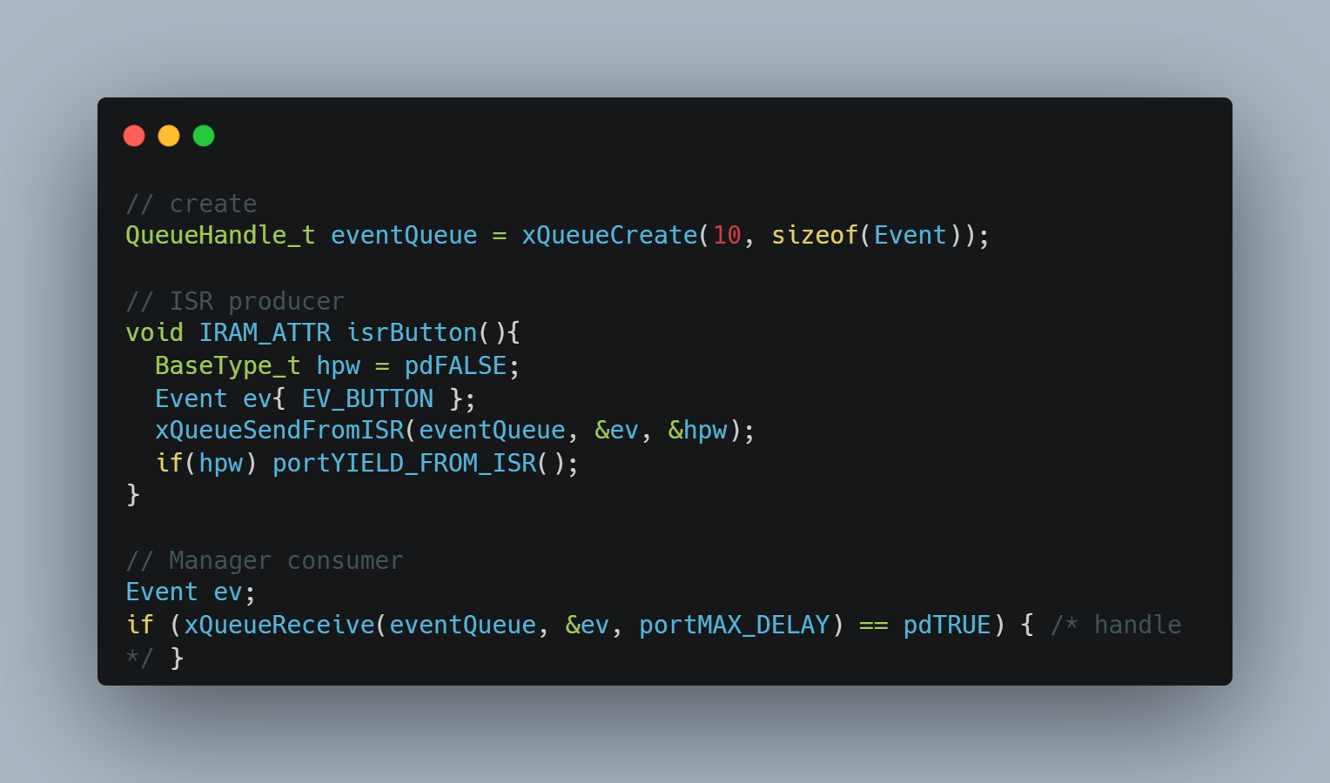
Queues (event-driven state machine)
Cross-task signals use a FreeRTOS queue: sensor/ISR produce events,
Manager consumes them deterministically. This decouples timing-critical producers from decision logic.

Slide 11
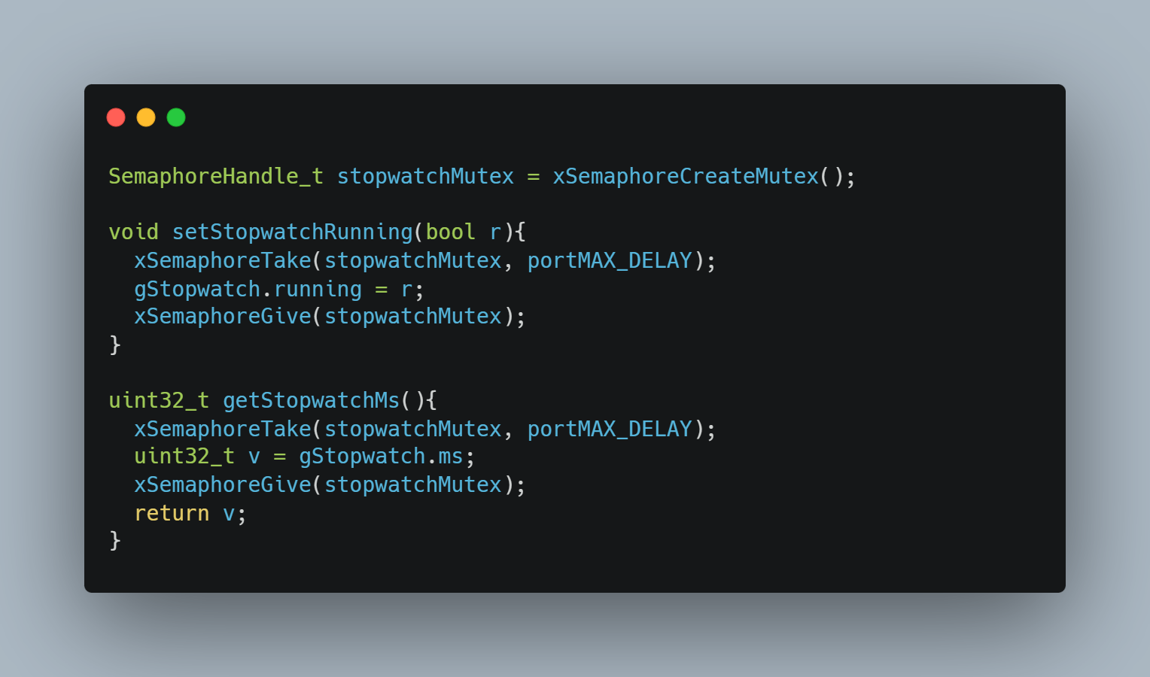
Mutex (shared stopwatch state)
A mutex protects shared variables (ms, running) to prevent races
when multiple tasks read/write. Keep critical sections short to minimize blocking and preserve timing.

Slide 12
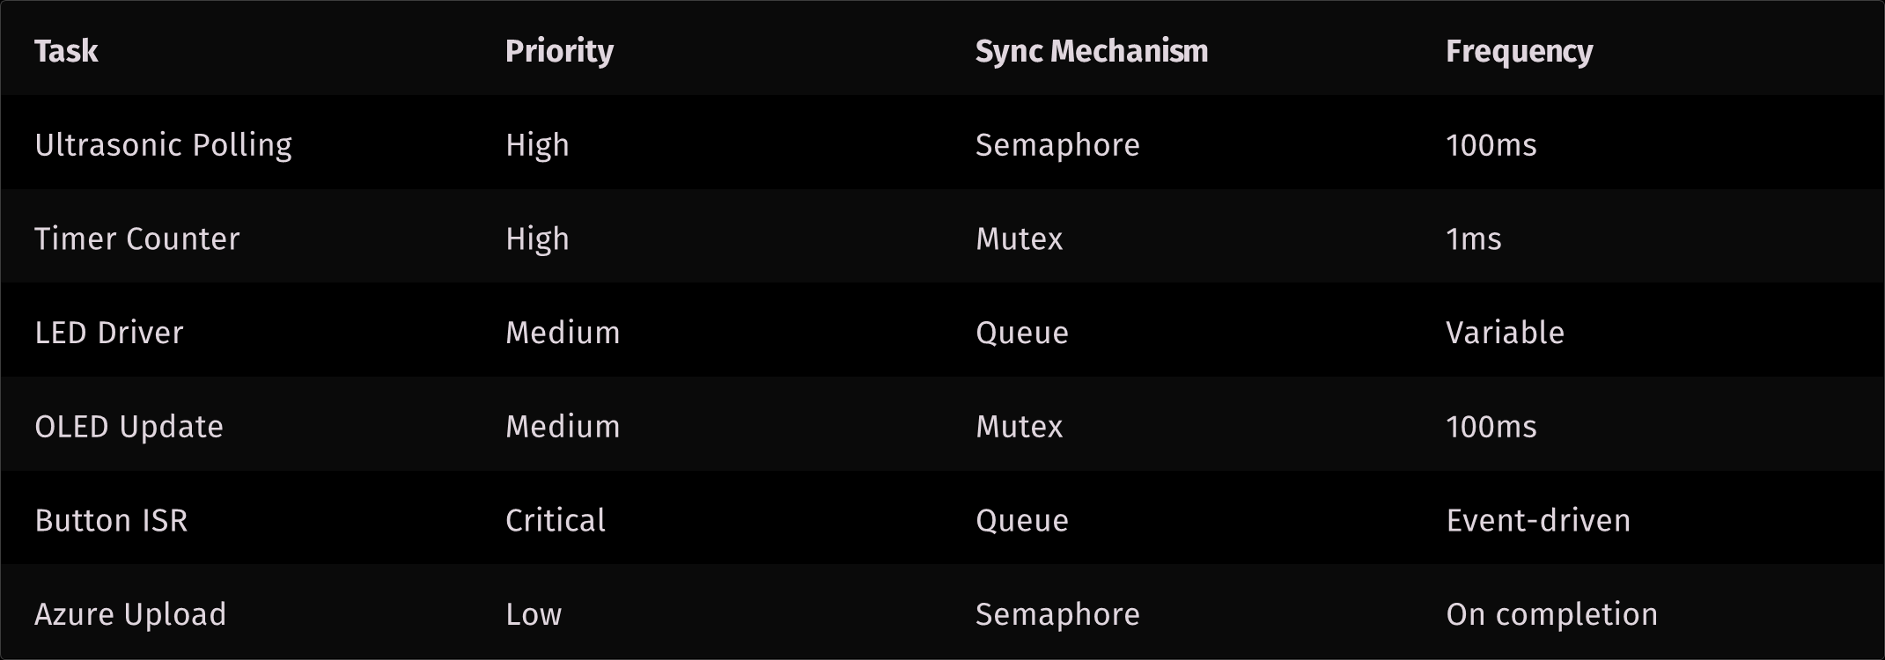
Core Tasks & Synchronization

Slide 13
That’s all? How do you see the data?

Slide 14
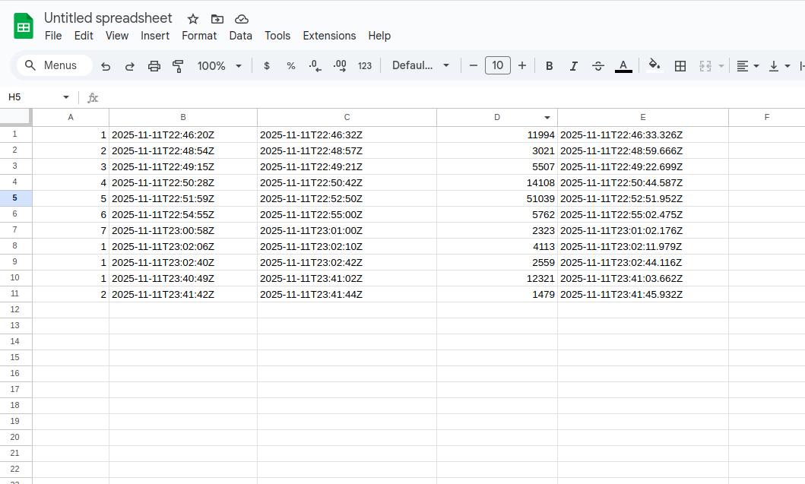


Data store and visualization
Upon job completion, ESP32-S3 transmits captured metrics data to Google Sheet nearly real-time for centralized monitoring and analytics.
Job Captured
Timer completes cycle
Data Packaged
Job #, start time, end time,
duration, insertedAt

Slide 15
Thank you
Do you want to see the live demo?

